Slide 1


//Developers_Institute_
TLV Coding Bootcamp
</Skin Care Cosmetics Trends>
Developers Institute ranked for Best Coding Bootcamp Worldwide for 2023
Azerbaijan 🇦🇿- México 🇲🇽 - Cameroon 🇨🇲 - Senegal 🇸🇳 - Burkina Faso 🇧🇫 - Mali 🇲🇱 - Ghana 🇬🇭 - Togo 🇹🇬 - Mauritius 🇲🇺 - Morocco 🇲🇦 - India 🇮🇳 - Georgia 🇬🇪 - Israël 🇮🇱

Slide 2


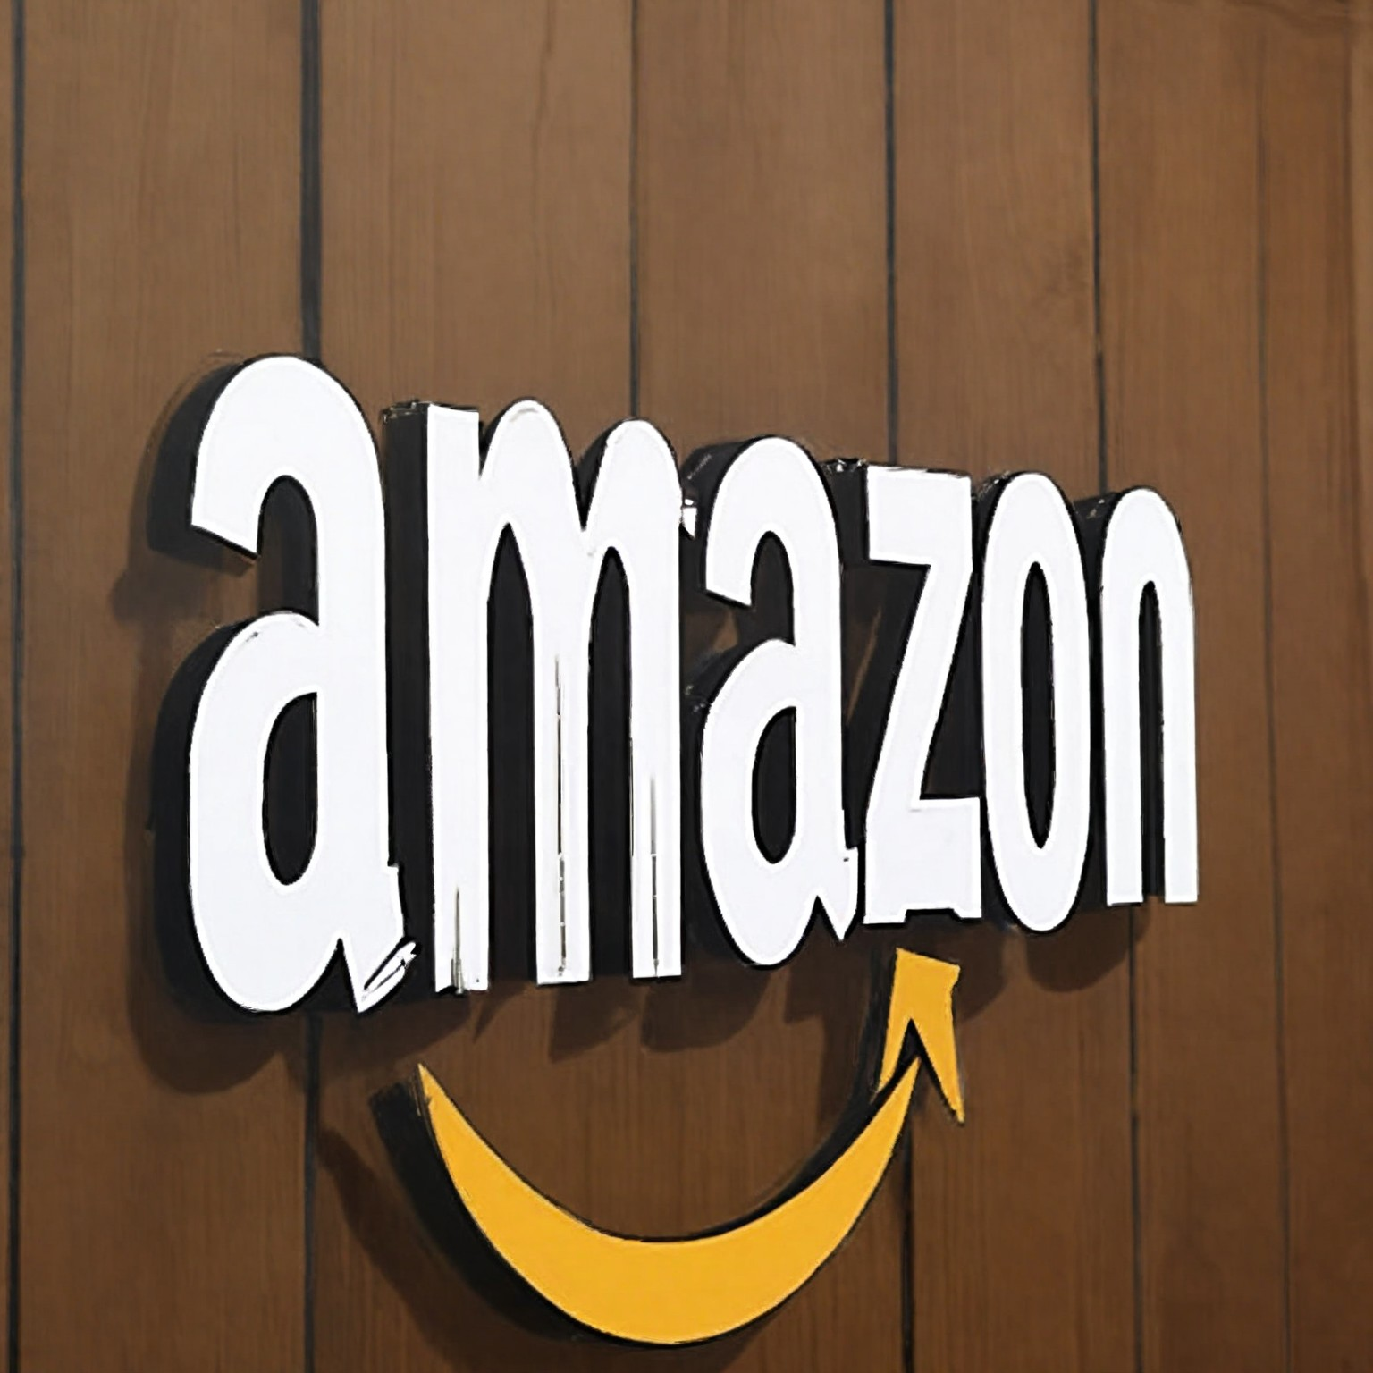

Cosmetics Market Trends
*Published by Statista
Top beauty purchase channels (according to the 2023 consumer survey):
Top online marketplaces: 27%
Retailer websites: 13%
Brand websites: 9%
Top countries by revenue in the 'Beauty Care' segment of the e-commerce market in 2023:
United States: $10.98 billion China: $10.54 billion Japan: $2.66 billion Germany: $1.94 billion
Top online beauty purchase channel of U.S. in 2023:
Amazon: 25% Walmart: 23% Beauty retailers' websites or apps: 14%
Top 25 beauty and personal care products sold on Amazon (for the first quarter of 2024):
Skincare items: 36% Tools and accessories: 20% Body and make-up products: 16%

Slide 3
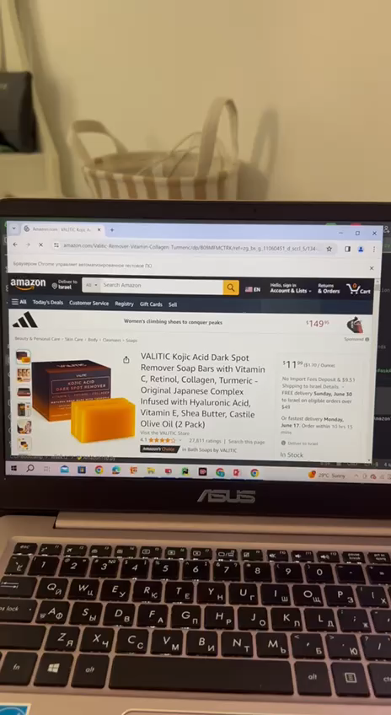
Data Collection
# Function to fetch the HTML content from the URL with retries and a delay
def fetch_page_with_retries_and_delay(url, retries=3, delay=10): # Increased delay to 10 seconds
headers = {'User-Agent': 'Mozilla/5.0 (Windows NT 10.0; Win64; x64) AppleWebKit/537.36 (KHTML, like Gecko) Chrome/91.0.4472.124 Safari/537.36' }
response.status_code == 200:
return response.text
…
for i in range(retries):
response = requests.get(url, headers=headers)
if return None # Function to extract product details from a given URL
def extract_product_details(url):
html_content = fetch_page_with_retries_and_delay(url)
if html_content:
soup = BeautifulSoup(html_content, 'html.parser')
items = soup.select('div.p13n-sc-uncoverable-faceout')
product_details = []
for item in items:
… product_details.append({
'product_title': product_title,
'product_url': product_url,
'img_url': img_url,
'product_star_rating': product_star_rating,
'product_num_ratings': product_num_ratings,
'product_price': product_price
})
return product_details
return [] # Define the URLs of the Amazon Best Sellers pages
url1 = "https://www.amazon.com/Best-Sellers-Beauty-Personal-Care-Skin-Care-Products/zgbs/beauty/11060451/ref=zg_bs_nav_beauty_1"
url2 = "https://www.amazon.com/Best-Sellers-Beauty-Personal-Care-Skin-Care-Products/zgbs/beauty/11060451/ref=zg_bs_pg_2_beauty?_encoding=UTF8&pg=2" # Extract product details from both URLs
product_details_url1 = extract_product_details(url1)
product_details_url2 = extract_product_details(url2) # Combine the results
all_product_details = product_details_url1 + product_details_url2
df_top_amazon = pd.DataFrame(all_product_details) # Create DataFrame
df_top_amazon.info() # Display DataFrame
Gathering relevant data in two different ways
API (from rapidapi.com) 2) Parsing HTML
url = "https://real-time-amazon-data.p.rapidapi.com/search"
country = "US"
query = "Skin Care"
total_pages = 200 # For example, retrieving 200 pages
products = []
for page in range(95, total_pages + 1):
querystring = {"query": query, "page": str(page), "country": country}
headers = {
"X-RapidAPI-Key": “MY KEY",
"X-RapidAPI-Host": "real-time-amazon-data.p.rapidapi.com"}
response = requests.get(url, headers=headers, params=querystring)
if response.status_code == 200:
products_on_page = response.json().get('data', {}).get('products', [])
products.extend(products_on_page)
else:
print(f"Failed to fetch page {page}: {response.text}")
# Convert the list of dictionaries into a DataFrame
df = pd.DataFrame(products)

Slide 4
Data Cleaning
Steps:
1) Remove columns that are either almost empty or not needed for analysis
2) Drop duplicates
3) Drop and handling missing values
4) Clean and convert price and purchase Data
5) Rename Columns
# | Column | Description | Count (Total Data) | Count (Top Data) | Dtype
0 | asin | The Amazon Standard Identification Number | 324 |  | object
1 | product_title | The title or name of the product listed on Amazon | 324 | 58 | object
2 | product_price | The price of the product | 324 | 58 | float64
3 | unit_price | The price per unit of the product | 324 |  | float64
4 | unit_count | The number of units included in the product package | 324 |  | int64
5 | product_star_rating | The average rating of the product based on customer reviews | 324 | 58 | float64
6 | product_num_ratings | The total number of ratings or reviews the product has received | 324 | 58 | int64
7 | product_url | The URL link to the product page on Amazon | 324 | 58 | object
8 | product_minimum_offer_price | The minimum offer price for the product | 324 |  | float64
9 | is_best_seller | Indicates whether the product is labeled as a best seller on Amazon | 324 (TRUE 19 from 324) | ALL | bool
10 | is_prime | Indicates whether the product is eligible for Amazon Prime | 324 |  | bool
11 | climate_pledge_friendly | Indicates whether the product is labeled as Climate Pledge Friendly | 324 |  | bool
11 | sales_volume_in_past_month | The sales volume of the product in the past month | 324 | 58 | int64
12 | delivery | Information about the delivery options available for the product | 324 |  | object

Slide 5
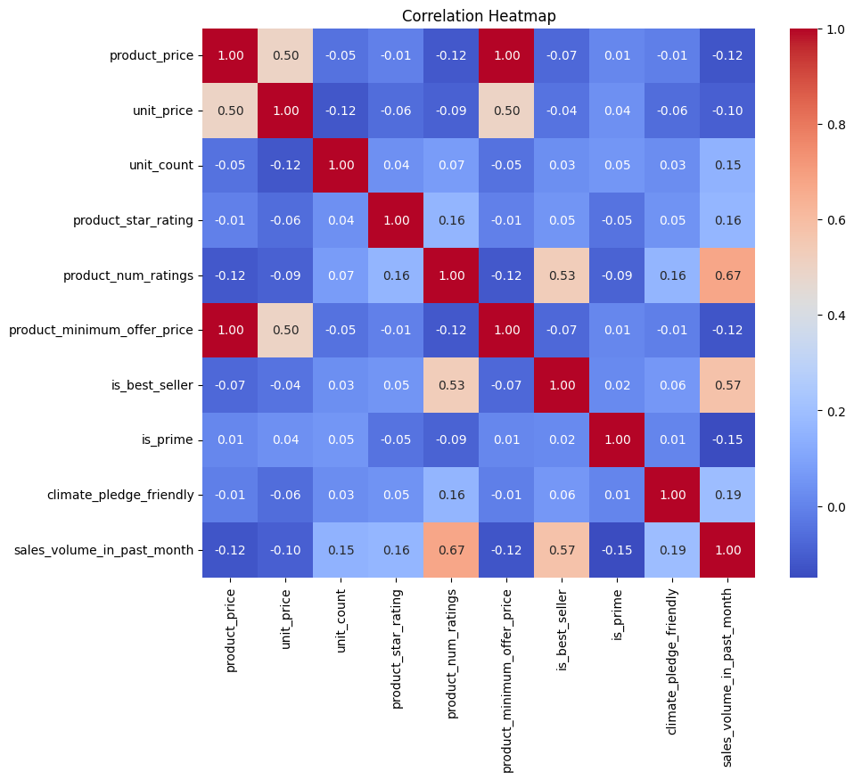
Data Exploration: Statistics of The First Total Data (From API)
Steps:
1) Computing Summary Statistics
2) Visualizing Distributions
3) Computing Correlation Matrix
4) Plotting Heatmap
5) T-Test
Based on the findings, it was decided to investigate the relationship between rating, price and sales volume per month in more detail. And add information such as Product Type, Brand Name and Review Text.

Slide 6
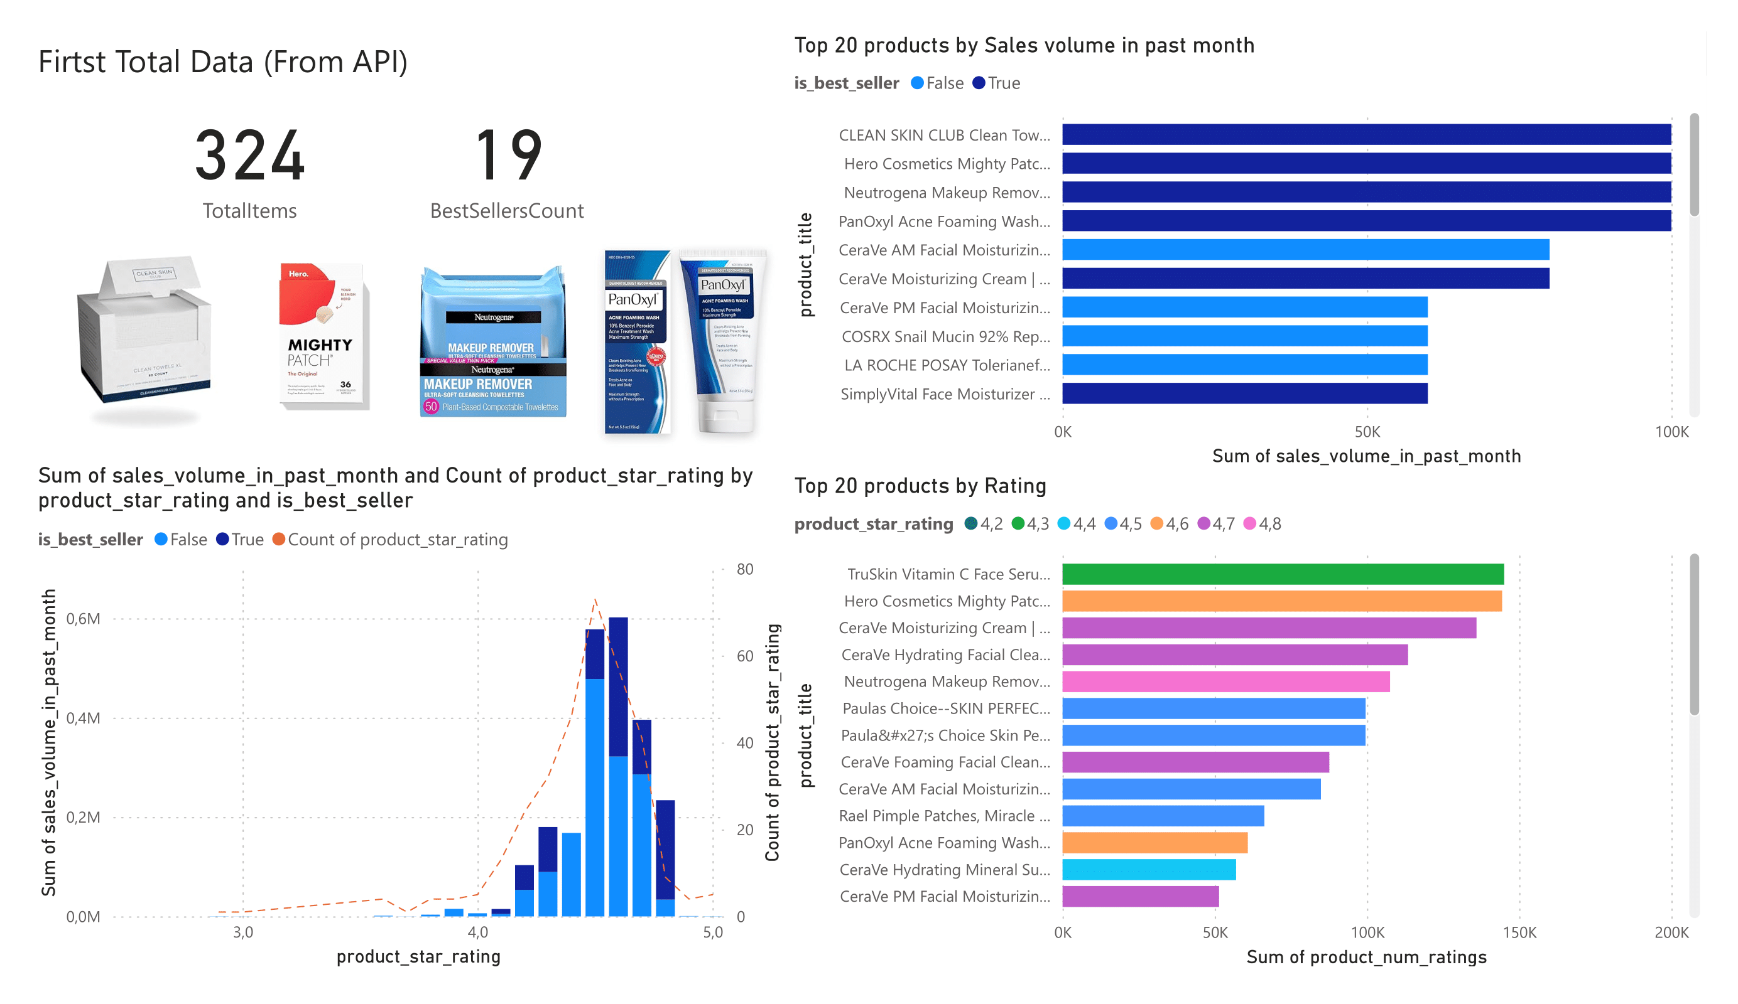
Dashboard (The Data from API)

Slide 7
Creating New Columns
sales_volume_in_past_month (for Top Data):
Parsing HTML + Handling missing values
brand:
Parsing HTML + Extracting information from column ‘product_title’
revenue:
sales_volume_in_past_month * product_price
product_type:
1. Extracting information from column ‘product_title’
2. NL Querying (API with Gemini)

Slide 8
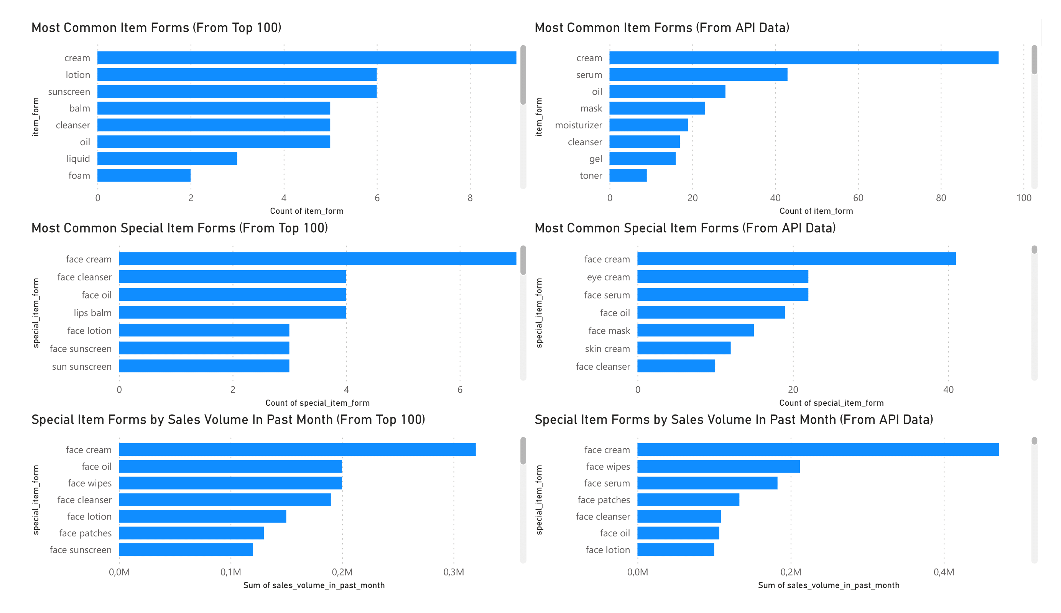
Comparing Data from Api and Top 100

Slide 9
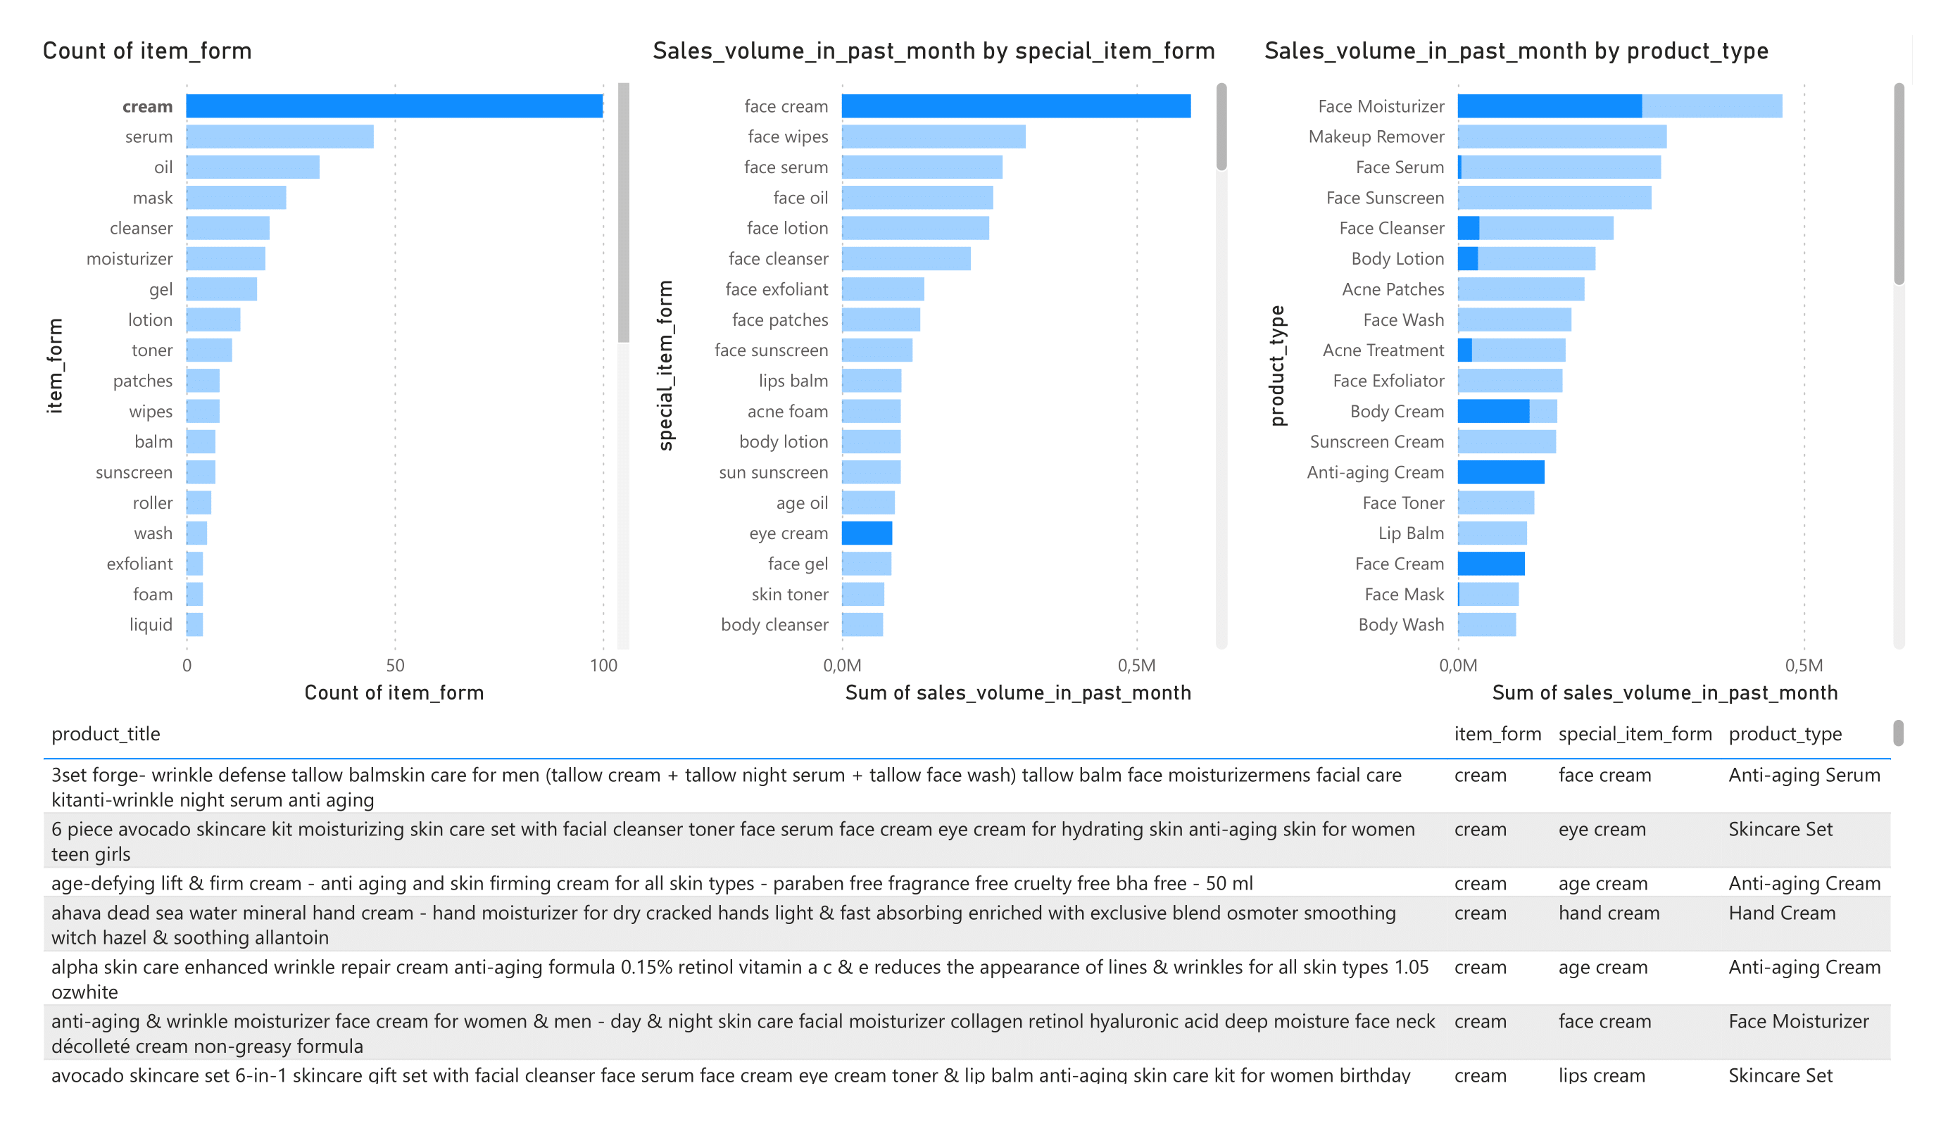
Comparing special_item_form and product_type

Slide 10
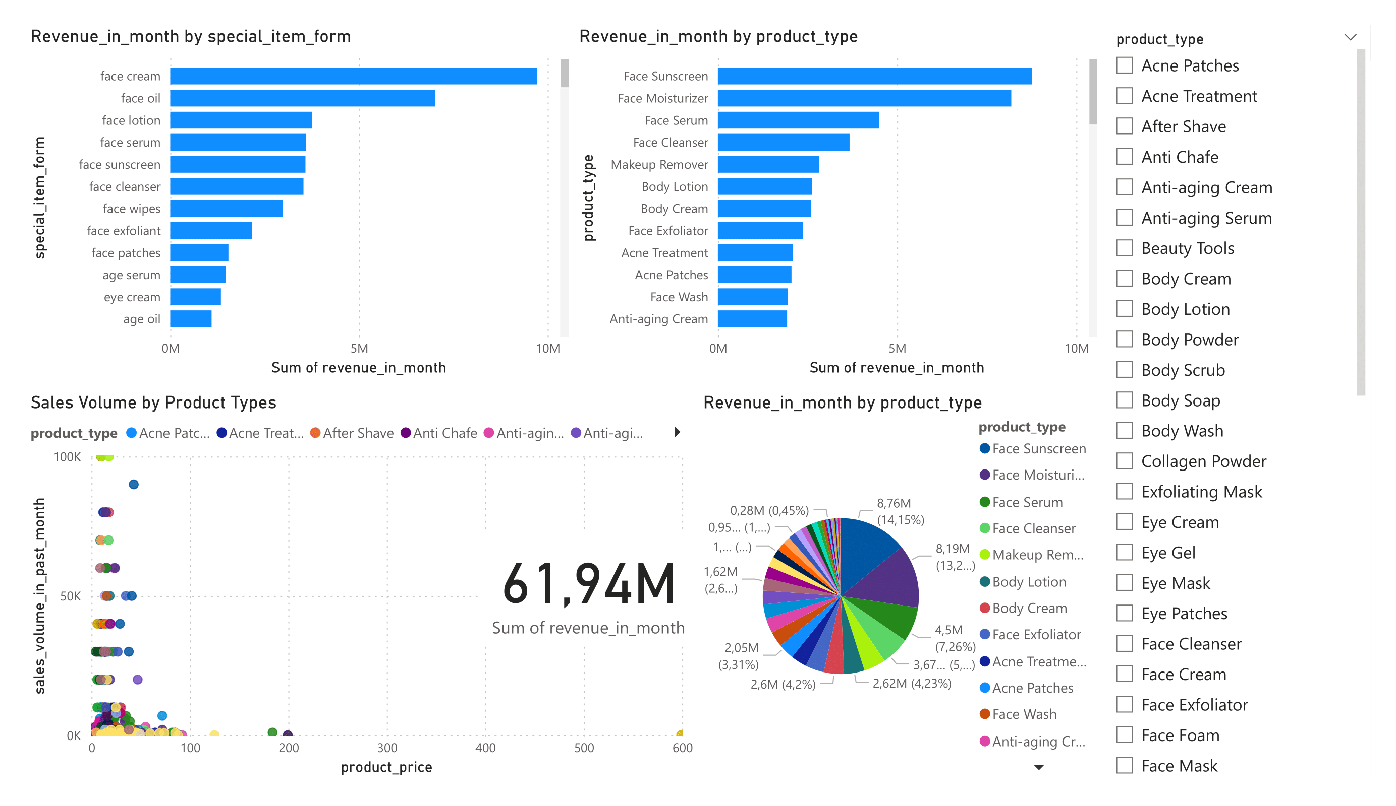
Price Analysis

Slide 11
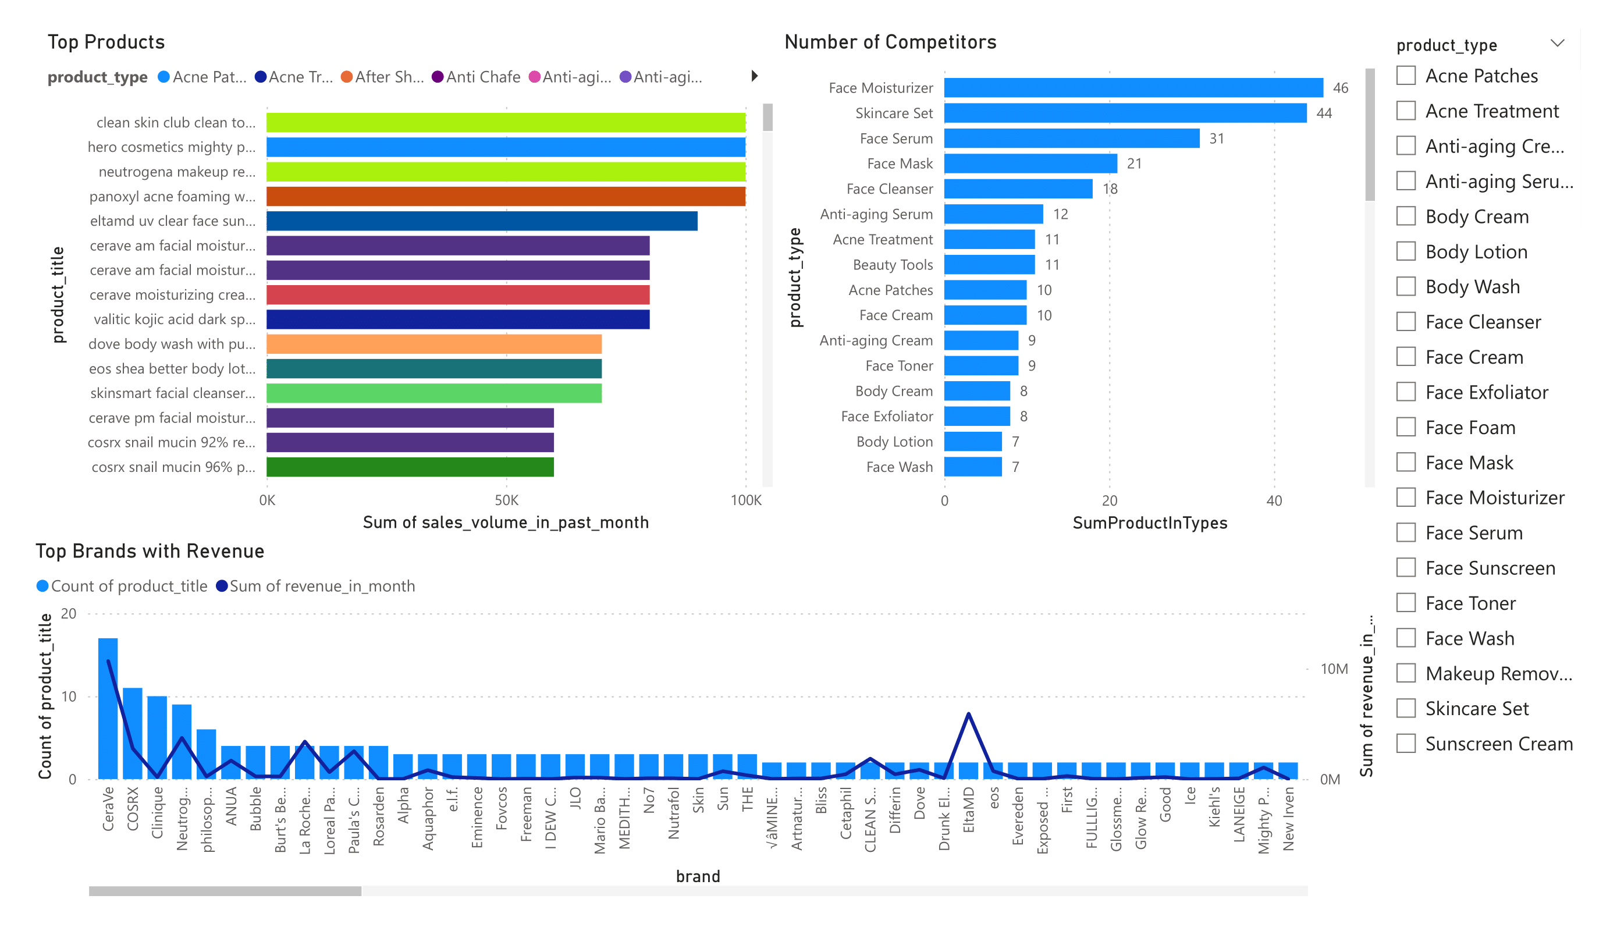
Brand Analysis

Slide 12
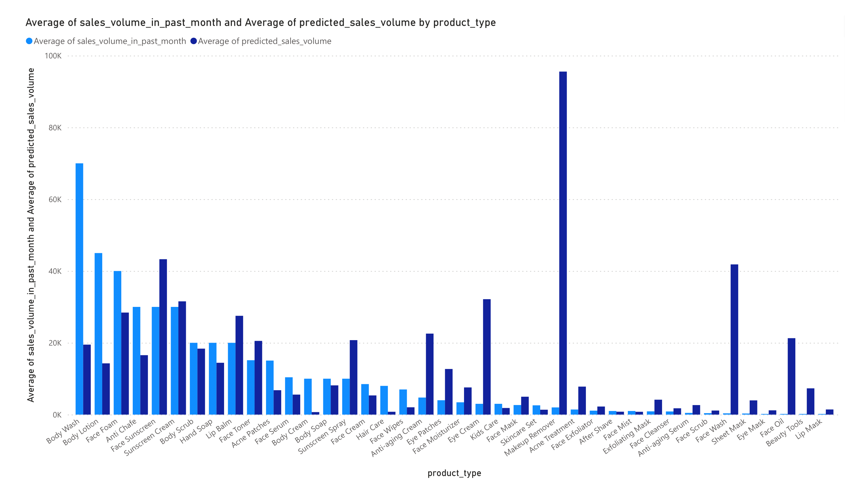
Machine learning
The goal: to predict sales volume based on product type, price and rating.
The model used in the code is a Random Forest Regressor
RMSE: 17089.21297940811
Feature Importance:
product_price 0.309555 product_star_rating 0.169587 product_type_Makeup Remover 0.136848
product_type_Face Sunscreen 0.071866
product_type_Face Wash 0.036803 product_type_Face Moisturizer 0.034905
product_type_Acne Patches 0.032535 product_type_Face Exfoliator 0.031464
product_type_Body Lotion 0.020631 product_type_Body Cream 0.019237
Custom Accuracy (within 10.0% deviation): 4.60%

Slide 13
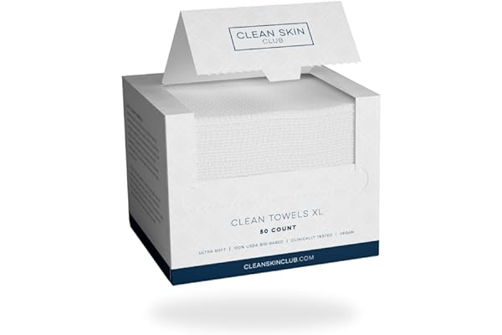
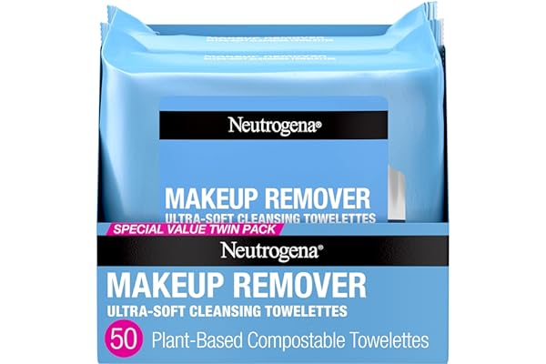
Some Feedback (web scraping using the Selenium library)
Customers like the quality, absorbency, effect on skin and size of the skin cleaning wipes. For example, they mention it's a high quality disposable towel, it absorbs all the water from their face and that it'll leave their skin super clean and refreshed. Some appreciate the softness. That said, some complain about the smell.
Customers like the softness, performance, quality and ease of removal of the skin cleaning wipe. For example, they mention it's gentle, works well and is effective at removing makeup. Some appreciate the ease of use. That said, opinions are mixed on moisture and effect on skin.

Slide 14
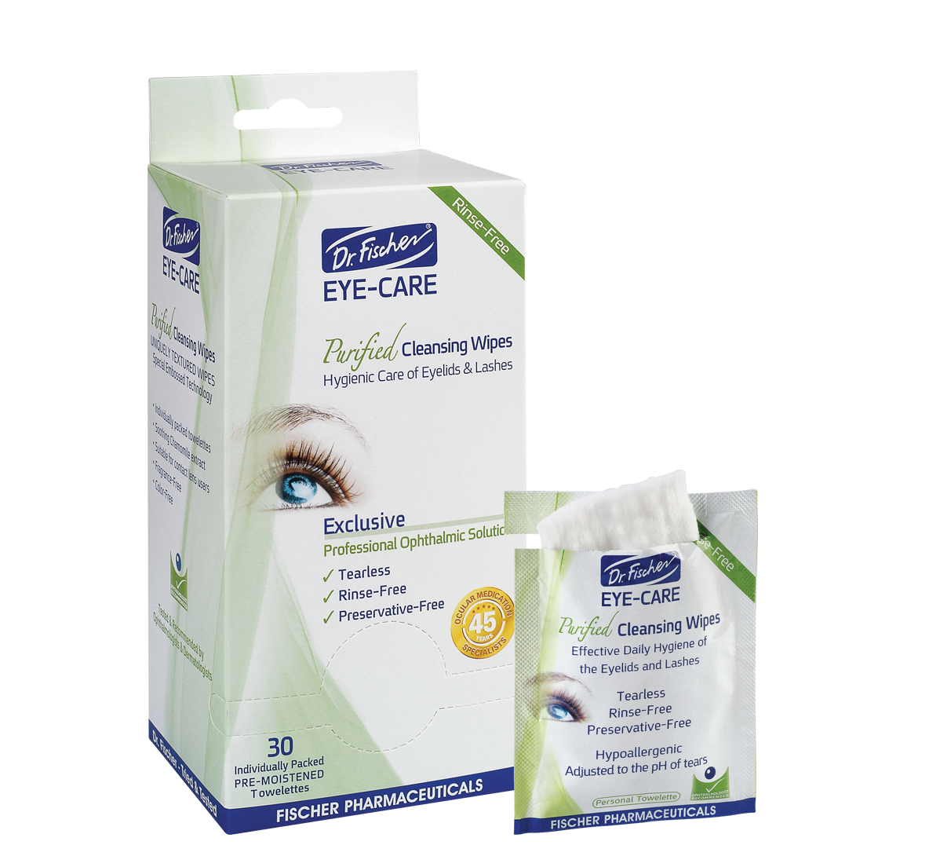
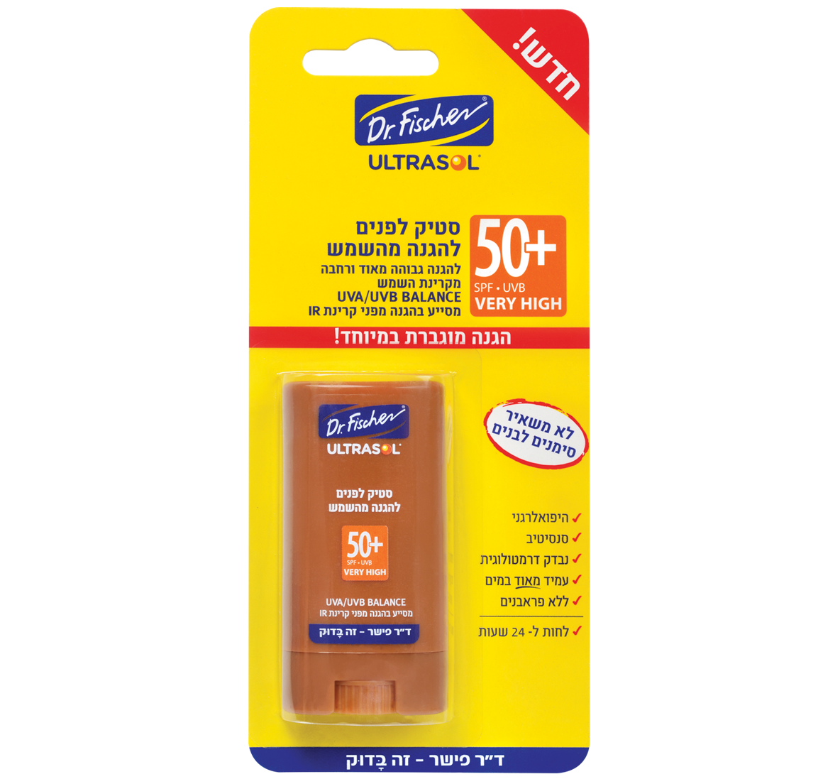
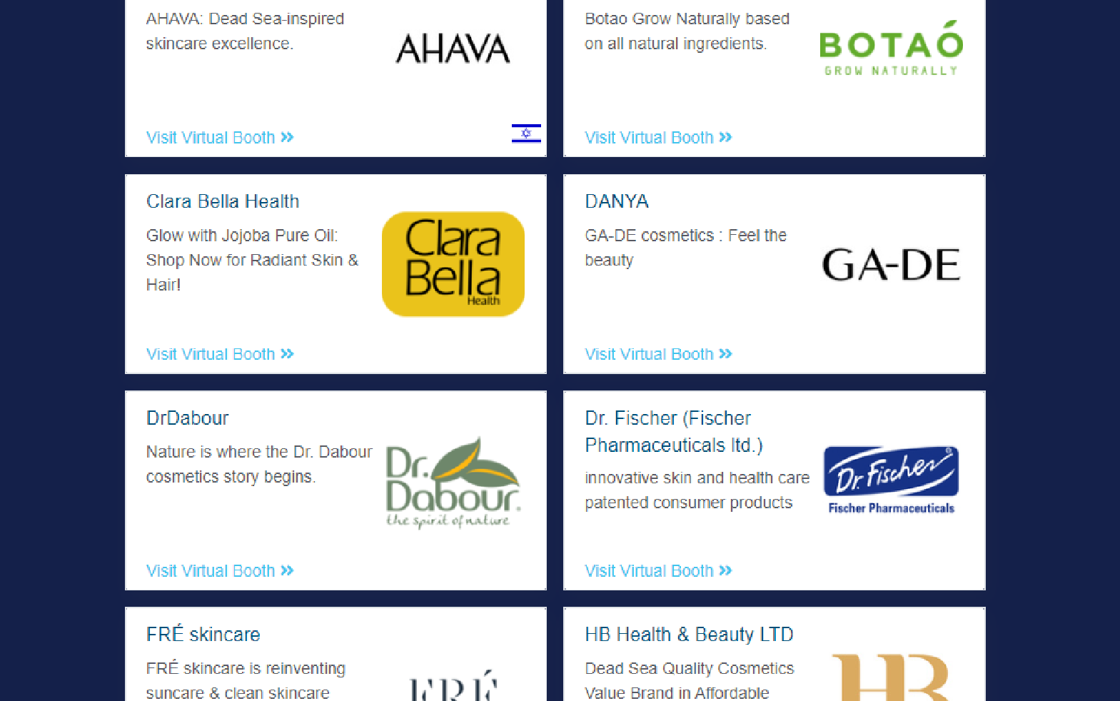
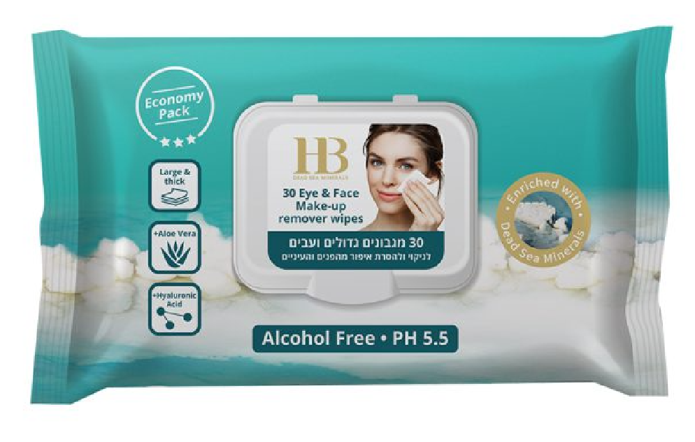
Skin Care Cosmetics Market in Israel
Catalog of ISRAEL EXPORT & INTERNATIONAL COOPERATION INSTITUTE (IEICI)

